Slide 1
BuddyCreeper - demo
Sahej Kaur

Slide 2
Overview
Who am I ?
Why so creepy ?
Demo
How did I do it?
Implications?
Questions?

Slide 3
Who am I?
Sehaj Kaur
Student
Focused on Web Programming
Flirting with Android

Slide 4
Why so creepy?
Ex boyfriends? No
Many services and APIs allow you to track people's locations
This can be exploited.
Social media is great for data mining. Locations can be a valuable dataset.
Inspired by Creepy.py (http://www.geocreepy.com/)
A Kali Linux tool used by penetration testers.

Slide 5
Demo
Twitter API
Fabric for Twitter API
AsyncTasks
Google maps API

Slide 6

Twitter Dev Account
Register for Dev account
Grab Twitter Key, twitter secret
Paramount to your app and its oauth thats facilitated by fabric
Provides UI helper classes
Get Urls for app

Slide 7
Fabric
Plugin for IDE
Helps integrate Twitter sdk into Android Studio
Gives functionality like:
Get current session
Get current user
Get timeline
Search by Username

Slide 8
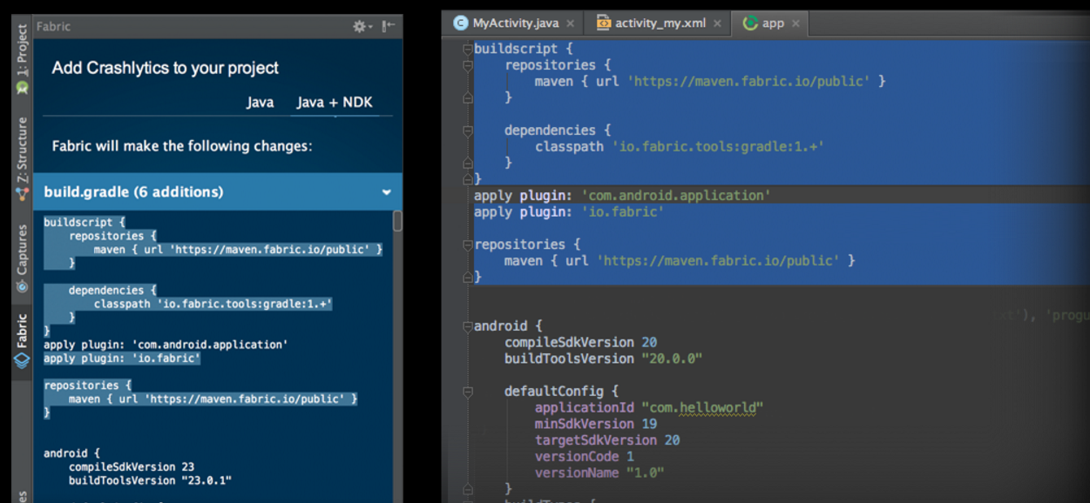

Slide 9
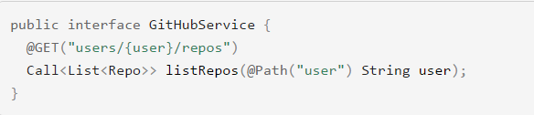
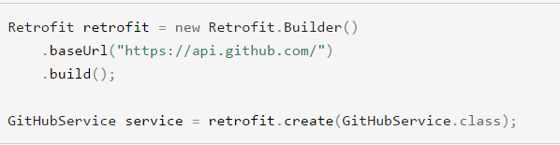

Retrofit - Http client

Slide 10
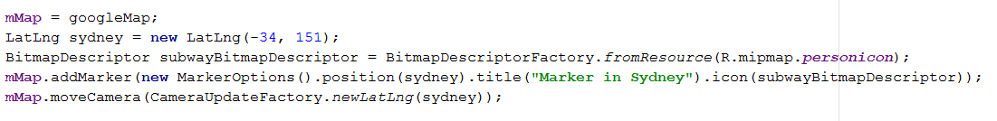
Google Maps API for Android
Get Key
Set markers on map , can set multiple markers
Manipulate infoWindowAdapters
Plot polygon coordinates

Slide 11
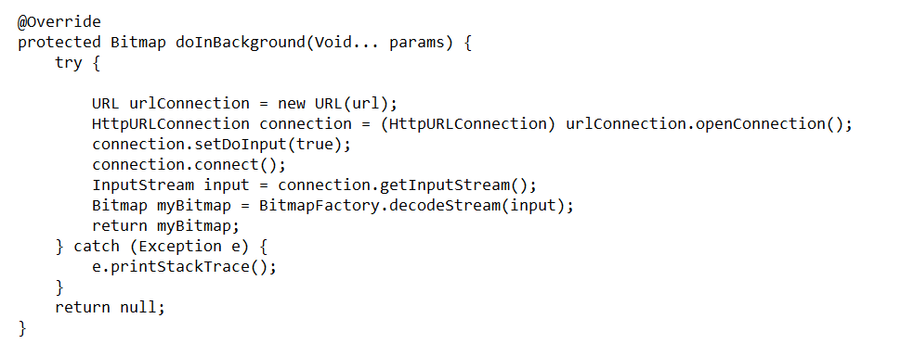
Async - Load Profile Picture

Slide 12
Implications
This can be extended to be as creepy as you like.
Add Flickr, Google plus, instagram and facebook (both deprecated)
You can potentially track a person's whereabouts throughout the day
Use this data to serve ads or whatever you’d like ( don’t creep on me tho)

Slide 13
Questions?

Slide 14
Thank you

